Slide 1

Exploratory Data Analysis
G2M insight for Cab Investment firm
by Mani Shanker Kamarapu
07/20/2023

Slide 2
Agenda
Executive Summary
Problem Statement
Approach
EDA
EDA Summary
Recommendations

Slide 3
Executive Summary
This analysis focuses on the US cab market, specifically comparing the performance of Yellow Cab and Pink Cab using transaction, customer, and city data.
Yellow Cab outperforms Pink Cab in terms of revenue and customer growth, indicating a strong market presence.
Pink Cab, while not as profitable, has a diverse customer base and shows potential for growth in specific markets.
Our recommendation for XYZ is to consider investing in Yellow Cab due to its superior performance and growth potential.
However, it's important for XYZ to also consider future market trends and strategic plans of both companies before making a final investment decision.

Slide 4
Problem Statement
XYZ, a US-based private firm, is exploring investment opportunities in the burgeoning cab industry and aims to make an informed decision based on a comprehensive market analysis.
The cab industry presents a potentially profitable investment due to its rapid growth, but it also poses risks due to high competition among key players.
The investment decision will significantly impact XYZ's financial outcomes, making a thorough market analysis crucial.
The main challenge for XYZ is to understand the intricacies of the cab market, including key players, customer demographics, and market trends.
This understanding will be achieved through a detailed analysis of various datasets, including transaction data, customer demographics, and city data.
The goal of the analysis is to provide actionable insights to guide XYZ in identifying the most promising investment opportunity.

Slide 5
Approach
The data from these 4 dataframes are merged into a new dataframe.
The data processing steps involve:
Reading the datasets into pandas dataframes.
Converting data types where necessary, for instance, 'Date of Travel' is converted from a numerical format to a datetime format.
Creating new features such as 'Income (USD/Month)' which is calculated as the product of 'Price Charged' and 'Customers’.
Cleaning the data by removing any null or missing values.

Slide 6
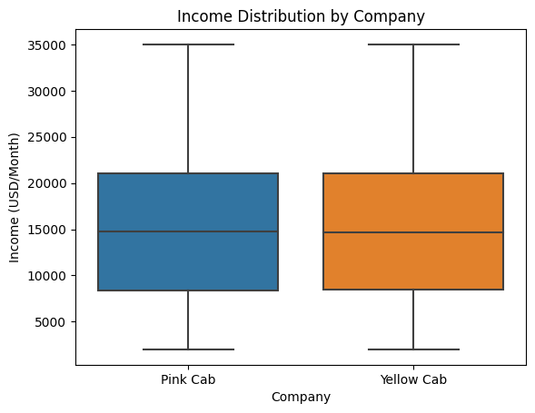
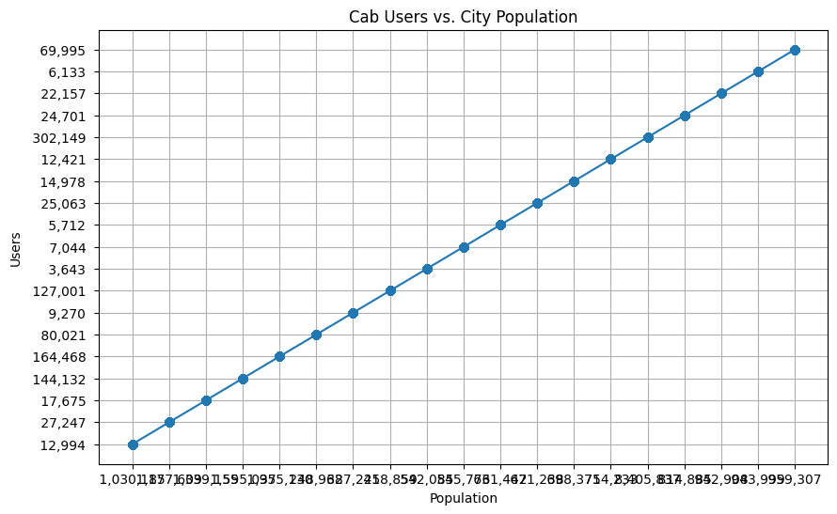
EDA

Slide 7
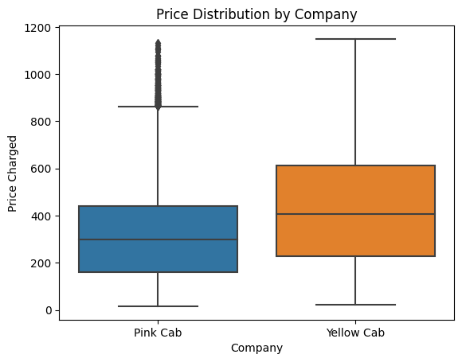
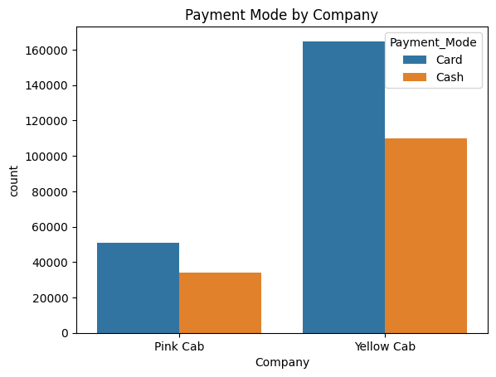

Slide 8
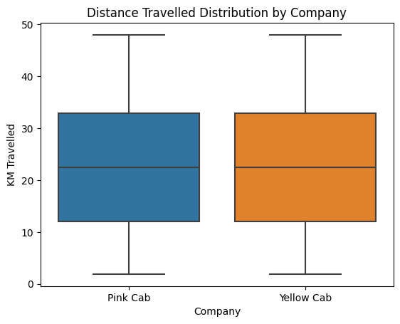
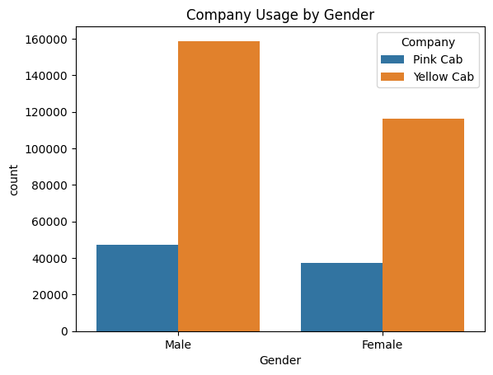

Slide 9
EDA Summary
Income of Customers: As the median income of customers using Pink Cab is same as Yellow Cab, it could suggest Yellow Cab as it is having more customers and be a positive sign for investment as higher income customers might be more willing to pay for premium services.
City Population and Cab Users: As there is a strong positive correlation between the population of a city and the number of cab users, it suggests that cab services are more popular in larger cities. The company that has a stronger presence in larger cities could be a better investment opportunity.
Price Charged: As the average price charged by Pink Cab is significantly lower than Yellow Cab, it could suggest that Pink Cab is more affordable and could attract more customers in the long run. However, a higher average price for Yellow Cab could also mean higher revenue per trip, which could be beneficial for investment.
Payment Mode: As both companies have a significantly higher proportion of card payments, it could suggest that the company's payment system is more convenient or trusted by customers. This could be a positive sign for investment in Yellow Cab with highest number of payments.
Distance Travelled: Customers of both companies tend to travel longer distances on average, it could indicate higher revenue per trip for that companies, which could be beneficial for investment.
Gender of Customers: Yellow Cab company has a significantly higher proportion of male and female customers, it could suggest that the company's services are more popular among both gender. The company has a more customer base and could be a better investment opportunity as it appeals to a wider market.

Slide 10
Recommendations
The Yellow Cab company that is performing better would be the one that shows positive signs in most of the above aspects.
However, the final decision should also take into account other factors such as the company's growth potential, market trends, competition, and the investor's risk tolerance and investment goals.

Slide 11
Thank You

